Slide 1
Weekly Report: MDM Narratives
Reporting Period:
9/16/22 - 9/23/22

Slide 2
Executive Summary
Seven high risk potential MDM narratives:
Election officials will commit election fraud to prevent Republican candidates from winning.
Provide public messaging about measures that help prevent election fraud.
Future elections can’t be trusted due to the fraudulent 2020 elections. (Continuing narrative)
Provide public messaging about Oregon historically holding free and fair elections.
Election fraud has been happening in Oregon for decades. (Continuing narrative)
Provide messaging about Oregon historically holding free and fair elections.
Mail-in ballots are used to commit voter and election fraud in Oregon. (Continuing narrative)
Provide messaging about measures that help prevent election fraud via mail-in ballots.
People should not trust voting machines because they enable election fraud. (Continuing narrative)
Provide public messaging about measures that help prevent election fraud via voting machines.
Oregon's elections are being controlled by out-of-state individuals through campaign donations. (Continuing narrative)
Do not address - continue to monitor.
Voter and election fraud occur through ballot harvesting. (Continuing narrative)
Provide messaging about measures that help prevent voter fraud via mail-in ballots.
A high volume of comments on two Gateway Pundit articles about the Oregon gubernatorial election led to increased dissemination of multiple narratives. The comments section in Gateway Pundit articles have previously generated threats to the lives of election officials in other states.
The Washington County trial led to increased dissemination of multiple narratives via Telegram posts from prominent election denier Dr. Frank that were forwarded to Oregon-specific channels.

Slide 3
National Trends & Developments
Users reacted positively to a recent court ruling in Texas that prevents large social media platforms from removing users’ posts for their political views and claimed that this will help prevent censorship. This could lead to a decrease in anti-big tech related MDM narratives.
POTUS 45 increasingly amplified QAnon related content, which could lead to an increase in election related MDM narratives.

Slide 4
MDM Narratives
Narrative | Description | Risk Level | Recommended Countermeasure | Recommended Countermeasure Details
1. Election officials will commit election fraud to prevent Republican candidates from winning. | Users on Twitter, Gettr, and in the comments sections on Gateway Pundit articles about the Oregon gubernatorial election claimed that election officials will commit election fraud to prevent Republican candidates from winning. Users claimed that the people who count votes have more influence than voters themselves, implying that election officials will alter votes. Some users also claimed that election officials will face negative ramifications if Republicans win. One user specifically referred to Multnomah County officials as “election-rigging fascists”. This narrative could negatively impact Oregon voters’ trust in Oregon’s electoral procedures and outcomes and the safety of election officials. | High | Public Messaging | Provide public messaging about measures that help prevent election fraud.

Slide 5
MDM Narratives
Narrative | Description | Risk Level | Recommended Countermeasure | Recommended Countermeasure Details
2. Future elections can’t be trusted due to the fraudulent 2020 elections. (Continuing narrative) | Users on Twitter, Facebook, Telegram, Gettr, and in the comments sections on Gateway Pundit articles about the Oregon gubernatorial election expressed that they don’t trust future elections’ results. Several users claimed that Democrats will cheat in future elections and one user suggested that Republicans should therefore also cheat. This narrative originated from national-level discourse. This narrative increased to high risk this reporting period (previously medium risk) due to increased dissemination. This narrative could negatively impact Oregon voters’ trust in election procedures and results. | High | Public Messaging | Provide public messaging about Oregon historically holding free and fair elections.

Slide 6
MDM Narratives
Narrative | Description | Risk Level | Recommended Countermeasure | Recommended Countermeasure Details
3. Election fraud has been happening in Oregon for decades. (Continuing narrative) | Users on Twitter, Facebook, and in the comments sections on Gateway Pundit articles about the Oregon gubernatorial election claimed that there has been election fraud in Oregon since the state switched to mail-in voting. They claimed that the prevalence of Democrats and lack of Republican winners is evidence of voter and election fraud. This narrative originated from national-level discourse about voter and election fraud. This narrative increased to high risk this reporting period (previously low) due to increased dissemination. This narrative could negatively impact Oregon voters’ trust in the outcomes of elections. | High | Public Messaging | Provide messaging about Oregon historically holding free and fair elections.

Slide 7
MDM Narratives
Narrative | Description | Risk Level | Recommended Countermeasure | Recommended Countermeasure Details
4. Mail-in ballots are used to commit voter and election fraud in Oregon. (Continuing narrative) | Users on Twitter, Facebook, Telegram, Getter,, and in the comments sections on Gateway Pundit articles about the Oregon gubernatorial election claimed that mail-in ballots are used to commit voter and election fraud in Oregon. One user suggested that voter fraud is more likely through automatic voter registration when Oregonians get their drivers’ license because ineligible voters receive mail-in ballots. This narrative could decrease Oregon voters’ confidence in the legitimacy of mail-in ballots as an election procedure. | High | Public Messaging | Provide messaging about measures that help prevent election fraud via mail-in ballots.

Slide 8
MDM Narratives
Narrative | Description | Risk Level | Recommended Countermeasure | Recommended Countermeasure Details
5. People should not trust voting machines because they enable election fraud. (Continuing narrative) | Users on Twitter, Telegram, Gettr, and in the comments sections on Gateway Pundit articles about the Oregon gubernatorial election claimed that Dominion voting machines use flawed tabulation processes and will alter votes in favor of Democrats. This narrative originated from national-level discourse and was amplified by users that self-identify as being from Oregon or contain “Oregon” in their social media handle. This narrative could negatively impact Oregon voters’ trust in Oregon’s electoral procedures and outcomes. | High | Public Messaging | Provide public messaging about measures that help prevent election fraud via voting machines.

Slide 9
MDM Narratives
Narrative | Description | Risk Level | Recommended Countermeasure | Recommended Countermeasure Details
6. Oregon's elections are being controlled by out-of-state individuals through campaign donations. (Continuing narrative) | Users on Twitter and Facebook implied that Oregon’s elections are being controlled by money from out-of-state individuals and companies (ex. George Soros, Mark Zuckerberg, and Apple). Some accused Oregon US Senator Jeff Merkley of receiving “dark money” donations. All posts within this narrative were replies to posts by Oregon US Senator Jeff Merkley expressing support for the DISCLOSE Act to get “dark money” out of elections. New York Times, Politico, and CNN articles about “dark money” donations to Democrats amplified this narrative. This narrative increased to high risk this reporting period (previously low risk) due to increased dissemination. This narrative could decrease Oregon voters’ confidence in the outcomes of elections. | High | Monitor | Do not address - continue to monitor.

Slide 10
MDM Narratives
Narrative | Description | Risk Level | Recommended Countermeasure | Recommended Countermeasure Details
7. Voter and election fraud occur through ballot harvesting. (Continuing narrative) | Users on Twitter, Gettr, and in the comments section on a Gateway Pundit article about the Oregon gubernatorial election claimed that ballot harvesting is used to commit voter and election fraud in Oregon. Several users claimed that Democrats will use boxes of illegitimate ballots to cheat and others conflated mail-in ballots with ballot harvesting. This narrative increased to medium risk this reporting period (previously low risk) due to increased dissemination. This narrative could decrease Oregon voters’ confidence in the legitimacy of election procedures. | High | Public Messaging | Provide messaging about measures that help prevent voter and election fraud.

Slide 11
MDM Narratives
Narrative | Description | Risk Level | Recommended Countermeasure | Recommended Countermeasure Details
8. Oregon’s mail-in ballots are not anonymous because they contain QR codes/unique identifiers. | Users on Telegram and Twitter claimed that Oregon’s mail-in ballots are not anonymous because they contain QR codes/unique identifiers. This narrative appeared to originate from a post by prominent election denier Dr. Frank about the Washington County v. Tim Sippel trial. This narrative could negatively impact Oregon voters’ participation and trust in the legitimacy of mail-in ballots as an election procedure participation. | Medium | Public Messaging | Provide messaging about procedures for mail-in ballots.

Slide 12
MDM Narratives
Narrative | Description | Risk Level | Recommended Countermeasure | Recommended Countermeasure Details
9. Oregon should eliminate mail-in ballots and hold in-person voting that requires voter ID. (Continuing narrative) | Users on Twitter, Telegram, Gettr, and in the comments sections on Gateway Pundit articles about the Oregon gubernatorial election called for Oregon to eliminate mail-in voting because the system is not secure and is vulnerable to voter and election fraud. These users expressed support for in-person voting, voter IDs, and paper ballots. This narrative originated from national-level discourse about voter and election fraud. This narrative increased to medium risk this reporting period (previously low risk) due to increased dissemination. This narrative could decrease Oregon voters’ confidence in the legitimacy of mail-in ballots as an election procedure. | Medium | Public Messaging | Provide messaging about measures that help prevent voter and election fraud via mail-in ballots.

Slide 13
MDM Narratives
Narrative | Description | Risk Level | Recommended Countermeasure | Recommended Countermeasure Details
10. Illegal immigrants are voting. (Continuing narrative) | Users on Twitter, Facebook, Gettr, and in the comments sections on Gateway Pundit articles about the Oregon gubernatorial election claimed illegal immigrants are voting. Some users claimed that Democrats rely on illegal immigrants’ votes to win elections. This narrative originated from national-level discourse and was amplified by users that self-identify as being from Oregon or from users containing “Oregon” in their social media handle. This narrative could negatively impact Oregon voters’ trust in Oregon’s electoral procedures and outcomes. | Medium | Public Messaging | Provide messaging about voter eligibility in Oregon.

Slide 14
MDM Narratives
Narrative | Description | Risk Level | Recommended Countermeasure | Recommended Countermeasure Details
11. People should monitor ballot drop boxes to prevent voter fraud. | Users on Oregon-specific Telegram channels and in the comments section on a Gateway Pundit article about the Oregon gubernatorial election called on people to monitor ballot drop boxes to prevent others from committing voter fraud by voting multiple times or other methods. This narrative originated from national-level discourse (see Trends & Development section of report covering 9/2-9/9). This narrative could negatively impact Oregon voters’ trust in Oregon’s electoral procedures and outcomes. | Low | Public Messaging | Provide messaging about measures that help prevent voter fraud via ballot drop boxes.

Slide 15
Appendix A:
Screenshots

Slide 16
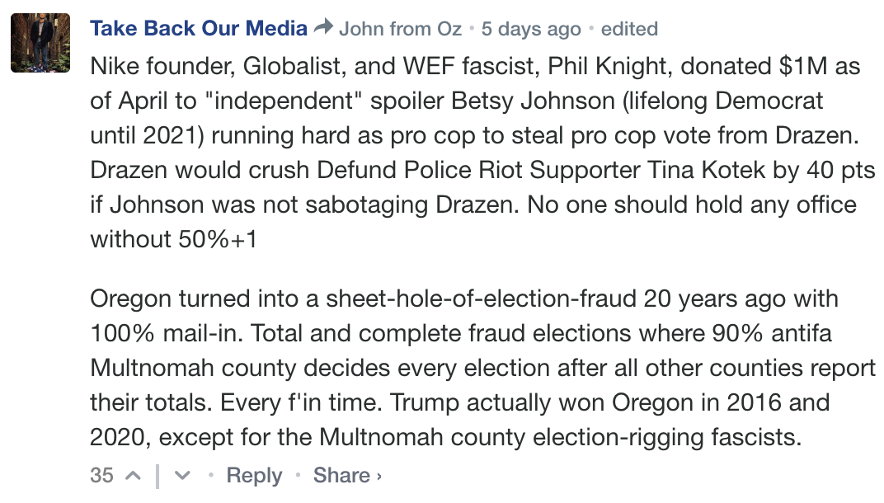
Narrative 1: Election officials will commit election fraud to prevent Republican candidates from winning.
(See link here.)
(See link here.)
(See link here.)

Slide 17
Narrative 2: Future elections can’t be trusted due to the fraudulent 2020 elections. (Continuing narrative)
(See link here.)
(See link here.)

Slide 18
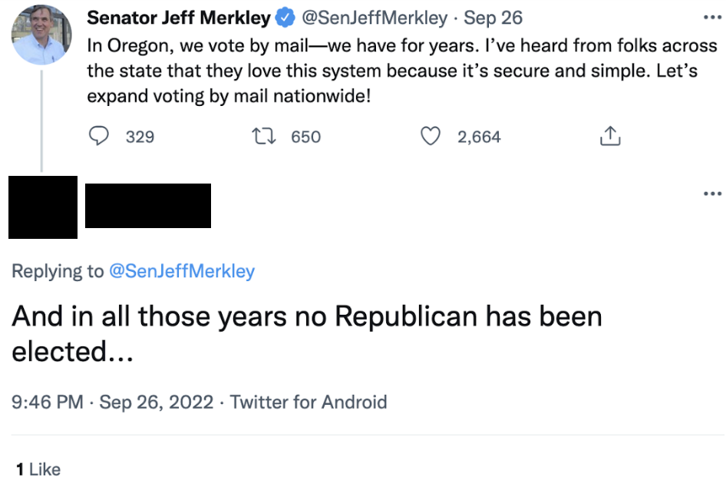
Narrative 3: Election fraud has been happening in Oregon for decades. (Continuing narrative)
(See link here.)
(See link here.)

Slide 19
Narrative 4: Mail-in ballots are used to commit voter and election fraud. (Continuing narrative)
(See link here.)
(See link here.)

Slide 20
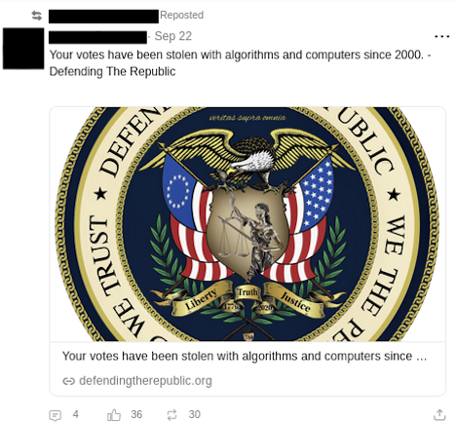
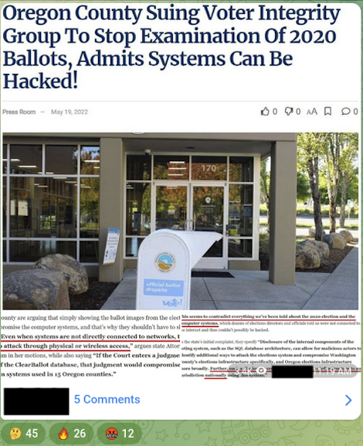
Narrative 5: People should not trust voting machines because they enable election fraud. (Continuing narrative)
(See link here.)
(See link here.)

Slide 21
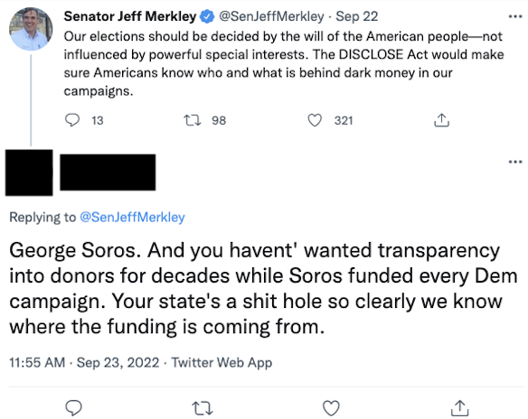
Narrative 6: Oregon's elections are being controlled by out-of-state individuals through campaign donations.
(See link here.)
(See link here.)

Slide 22
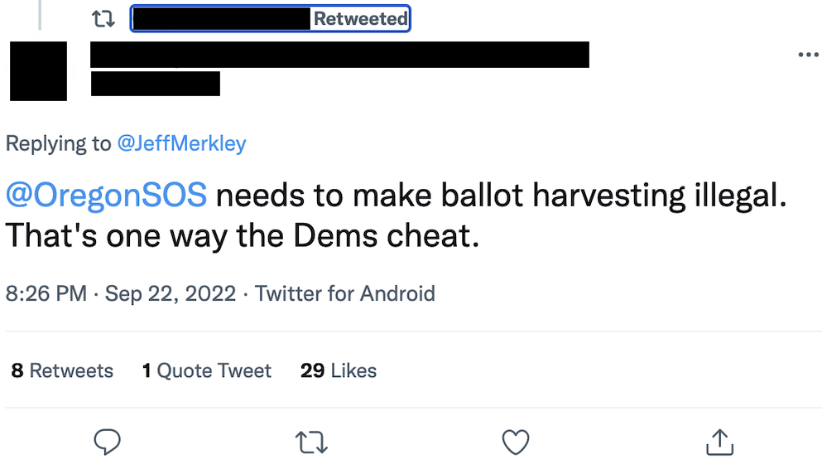
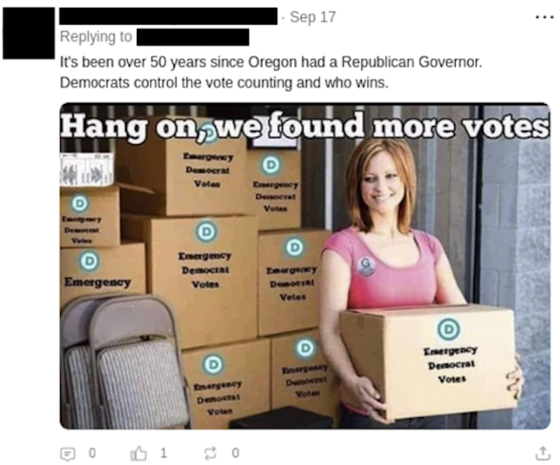
Narrative 7: Voter and election fraud occur through ballot harvesting. (Continuing narrative)
(See link here.)
(See link here.)
(See link here.)

Slide 23
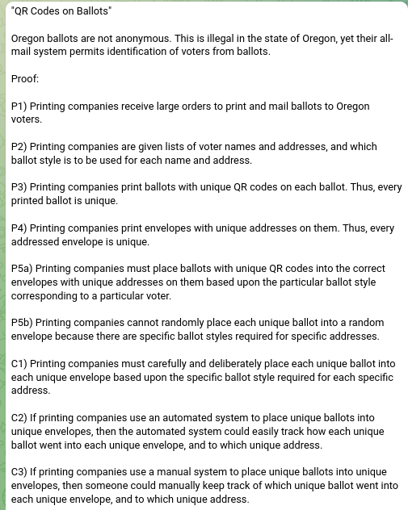
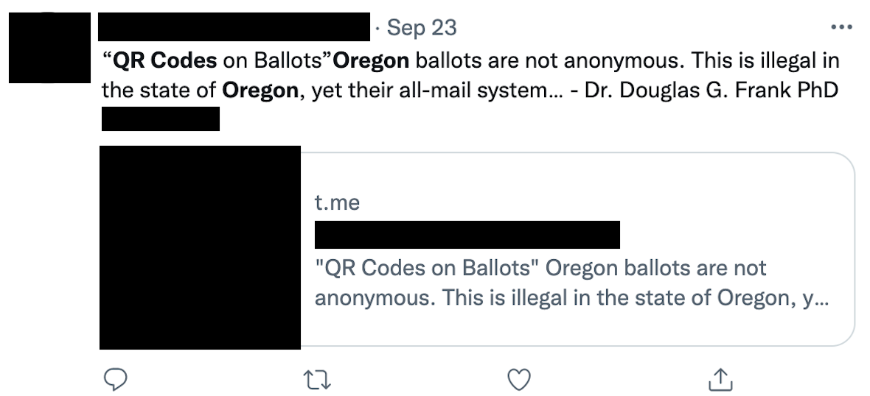
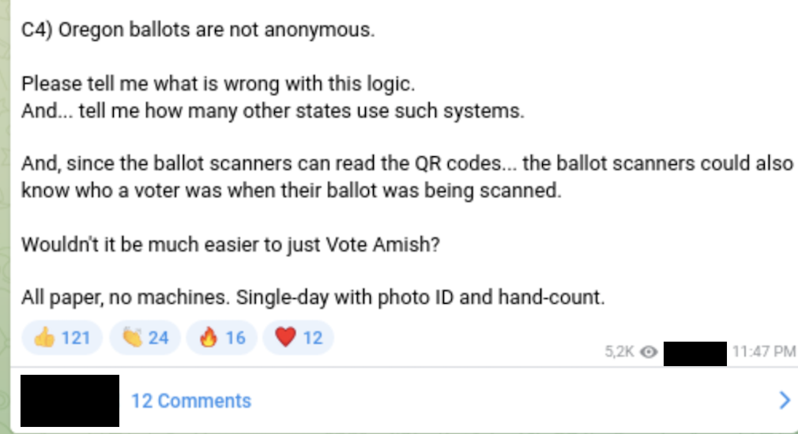
Narrative 8: Oregon’s mail-in ballots are not anonymous because they contain QR codes/unique identifiers.
(See link here.)
(See link here.)

Slide 24
Narrative 9: Oregon should eliminate mail-in ballots and hold in-person voting that requires voter ID. (Continuing narrative)
(See link here.)
(See link here.)

Slide 25
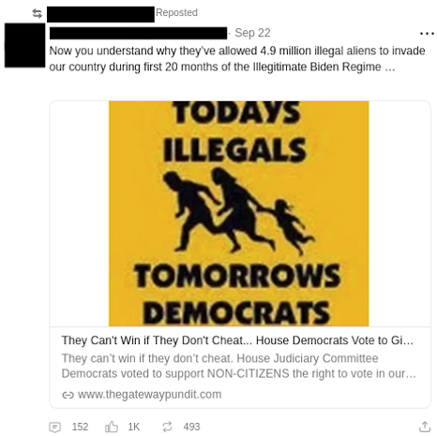
Narrative 10: Illegal immigrants are voting. (Continuing narrative)
(See link here.)
(See link here.)

Slide 26
Narrative 11: People should monitor ballot drop boxes to prevent voter fraud.
(See link here.)
(See link here.)

Slide 27
Appendix B:
Existing MDM Narratives

Slide 28
Existing MDM Narratives
Narrative | Risk | Reporting Period(s) Observed | Continuing (Yes/No)
Oregon election officials are not being transparent about the election process. | Low | 8/12-8/19, 8/19-8/26; 8/26-9/2; 9/2-9/9; 9/16-9/23 | Yes
Oregon election officials committed election fraud by altering voters’ registration. | Medium | 8/12-8/19 | No
Mail-in ballots are used to commit election fraud as non-Oregon residents are voting. | Low | 8/12-8/19; 8/19-8/26; 8/26-9/2; 9/2-9/9; 9/9-9/16; 9/16-9/23 | Yes
HB 3291 will open the midterm election to more voter and election fraud. | Low | 8/26-9/2; 9/16-9/23 | Yes

Slide 29
Existing MDM Narratives
Narrative | Risk | Reporting Period Observed | Continuing (Yes/No)
People can vote multiple times via mail-in ballots. | Low | 8/12-8/19; 8/19-8/26; 8/26-9/2; 9/2-9/9; 9/9-9/16; 9/16-9/23 | Yes
Oregon should conduct a full election audit due to widespread election fraud. | Low | 7/15-8/12; 8/12-8/19; 8/19-8/26; 8/26-9/2; 9/2-9/9; 9/9-9/16 | Yes
People should not trust mail-in ballots because signature verification is ineffective. | Low | 8/12-8/19; 8/19-8/26; 8/26-9/2 | No
Peoples’ votes for POTUS 45 in the 2020 election were not counted. | Medium | 8/12-8/19 | No

Slide 30
Existing MDM Narratives
Narrative | Risk | Reporting Period Observed | Continuing (Yes/No)
Twitter will influence the outcome of the 2022 midterm elections by enforcing its Civic Integrity Policy. | Low | 7/15-8/12 | No
Allowing same day registration will increase the likelihood of voter fraud and election fraud through mail-in voting. | Low | 8/19-8/26 | No
The US Postmaster General should be replaced for mail-in voting to be secure. | Low | 8/26-9/2; 9/9-9/16; 9/16-9/23 | Yes

Slide 31
Existing MDM Narratives
Narrative | Risk | Reporting Period Observed | Continuing (Yes/No)
People are using mail-in ballots received by deceased people in Oregon to commit voter fraud. | Low | 8/12-8/19; 8/19-8/26; 8/26-9/2; 9/2-9/9; 9/9-9/16; 9/16-9/23 | Yes
Allowing formerly incarcerated individuals’ to vote enables voter and election fraud. | Low | 9/2-9/9; 9/9-9/16 | No
Election officials are setting unreasonably high prices to block access to election records. | Low | 9/2-9/9 | No
Oregon election officials need to update voter rolls to prevent voter fraud. | Low | 8/12-8/19; 8/19-8/26; 8/26-9/2; 9/2-9/9; 9/16-9/23 | Yes

Slide 32
Appendix C: Definitions

Slide 33
Definitions
Misinformation - false, but not created or shared with the intention of causing harm
Disinformation - deliberately created to mislead, harm, or manipulate a person, social group, organization, or country
Malinformation - based on fact, but used out of context to mislead, harm, or manipulate
Topic - the broader subject defining the information environment (ex. Midterm Elections)
Theme - subtopics or categories of discourse (ex. Mail-in ballots)
Narrative - at least more than one piece of content that shares a similar rhetorical objective (ex. County clerks are using mail-in ballots to steal elections)
Voter Fraud - unlawful voting by individuals (ex. voting more than once)
Election Fraud - unlawful actions that undermine election integrity (ex. tampering with official election materials)

