Slide 1
Weekly Report: MDM Narratives
Reporting Period:
10/14/22 - 10/21/22

Slide 2
Executive Summary
4 high risk potential MDM narratives:
Oregon's elections are being controlled by out-of-state individuals through campaign donations. (Continuing narrative)
Mail-in ballots are used to commit voter and election fraud in Oregon. (Continuing narrative)
Future elections can’t be trusted due to the fraudulent 2020 elections. (Continuing narrative)
Oregon should eliminate mail-in ballots and hold in-person voting that requires voter ID. (Continuing narrative)
Users online continued discussing submitting their ballots in person.
A high volume of replies to several Twitter and Facebook posts by Oregon US Senator Jeff Merkley led to increased dissemination of multiple narratives.
POTUS 46’s appearance in Oregon to campaign for Oregon gubernatorial candidate Tina Kotek generated significant online discussion.
Users online continued efforts to organize canvassing in Douglas County, Marion County, Clackamas County, Gladstone, Oregon, and Salem, Oregon.
A user on Rumble posted a video titled “THE CURIOUS CASE OF COOS COUNTY” that repeated multiple previously reported election-related MDM narratives and has 7,128 views. The link to this video was circulated in various Oregon-specific Telegram channels.

Slide 3
National Trends & Developments
Users online discussed Nike CEO Phil Knight’s donation to Oregon gubernatorial candidate Christine Drazan. Some users contrasted his individual donation to a conservative candidate with Nike being a liberal company. Some users claimed that this donation meant Drazan is not conservative enough as Phil Knight was labeled “not MAGA.”
Users online continued to discuss monitoring drop boxes. Some users posted videos or photos of alleged “ballot mules” dropping off 2022 midterm ballots in Arizona and other unidentified states.

Slide 4
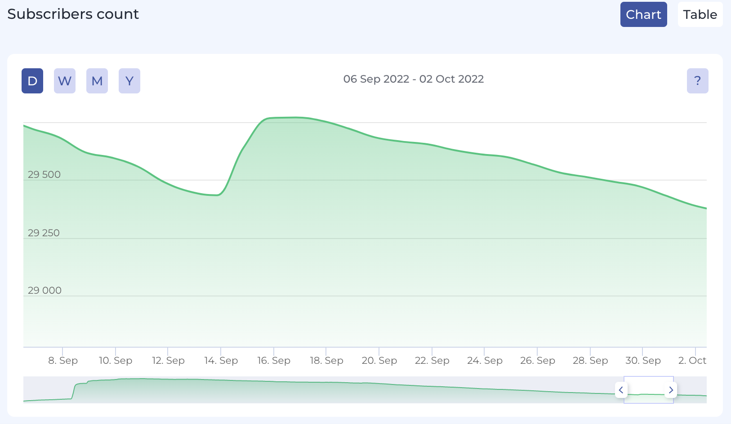
“Follow the Data with Dr Frank” Telegram Channel: Subscribers by Day
2
3
1
Dr. Frank speaks at election event in Northern California - appears to result in an increase in the number of subscribers.
Dr. Frank announces his testimony in the Washington County v. Tim Sippel Trial in Oregon Channel - does not appear to affect the number of subscribers.
Dr. Frank testifies at Tim Sippel v. Washington County trial and posts about the trial in his Telegram channel - does not appear to affect the number of subscribers.

Slide 5
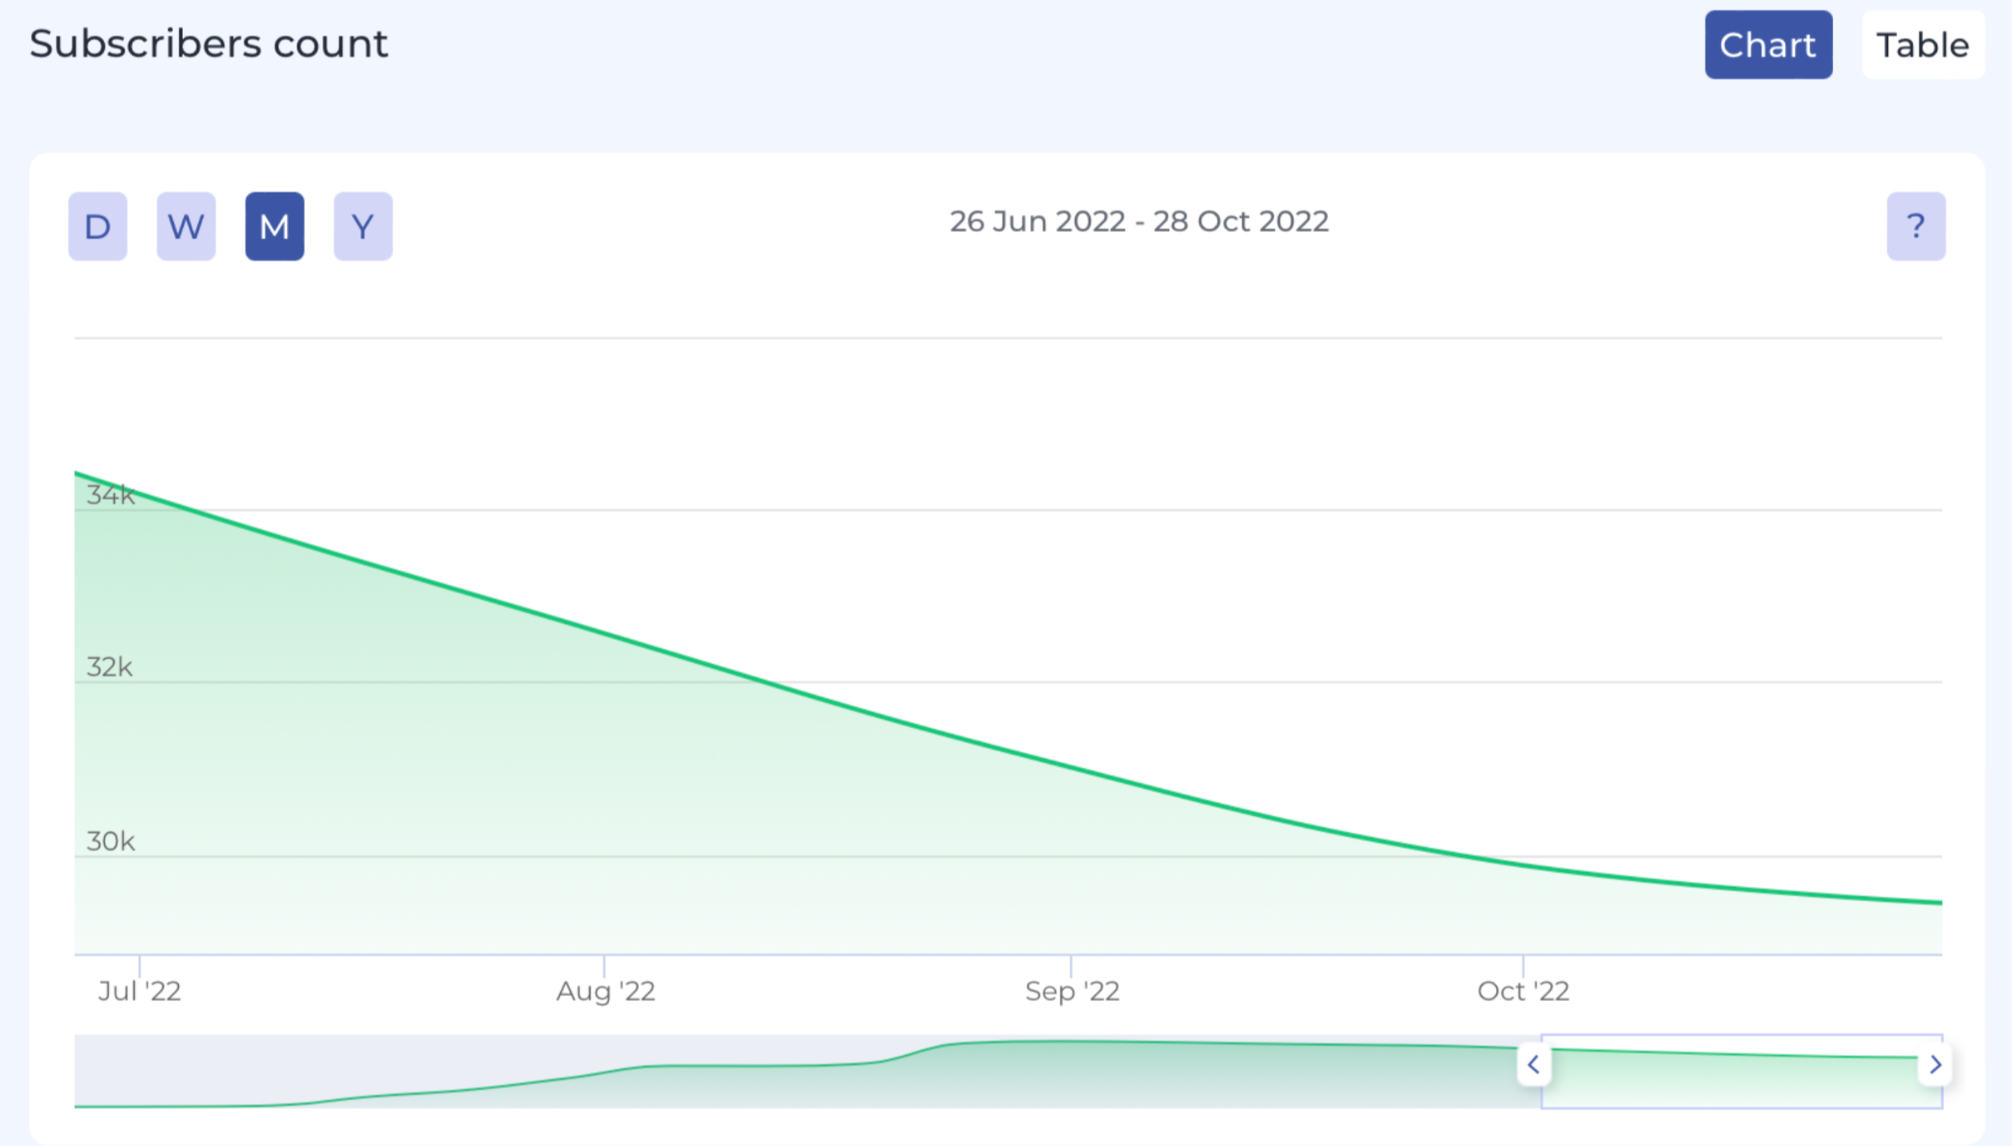
“Follow the Data with Dr Frank” Telegram Channel: Subscribers by Month
Despite the spike in subscribers shown in the previous slide, the number of overall subscribers has consistently decreased since July 2022.

Slide 6
MDM Narratives
Narrative | Description | Risk Level | Recommended Countermeasure | Recommended Countermeasure Details
1. Oregon's elections are being controlled by out-of-state individuals through campaign donations. (Continuing narrative) | Users on Twitter and Facebook implied that Oregon’s elections are being controlled by money from out-of-state individuals, companies, or countries (e.g., George Soros, Jeff Bezos, Mark Zuckerberg, China). Some accused Oregon US Senator Jeff Merkley and other democratic politicians of receiving “dark money” donations. All posts within this narrative were replies to posts by Oregon US Senator Jeff Merkley. This narrative increased to high risk this reporting period (previously low risk) due to increased dissemination. This narrative could decrease Oregon voters’ confidence in the outcomes of elections. | High | Monitor | Do not address - continue to monitor.

Slide 7
MDM Narratives
Narrative | Description | Risk Level | Recommended Countermeasure | Recommended Countermeasure Details
2. Oregon should eliminate mail-in ballots and hold in-person voting that requires voter ID. (Continuing narrative) | ​​Users on Twitter, Facebook, and Telegram called for Oregon to eliminate mail-in voting because the system is vulnerable to voter and election fraud. Users expressed support for in-person voting, voter IDs, and paper ballots. This narrative originated from national-level discourse about voter and election fraud. This narrative increased to high risk this reporting period (previously medium risk) due to increased dissemination. This narrative could decrease Oregon voters’ confidence in the legitimacy of mail-in ballots as an election procedure. | High | Public Messaging | Provide messaging about measures that help prevent voter and election fraud via mail-in ballots.

Slide 8
MDM Narratives
Narrative | Description | Risk Level | Recommended Countermeasure | Recommended Countermeasure Details
3. The US Postmaster General should be replaced for mail-in ballots to be secure. (Continuing narrative) | ​​Users on Twitter and Facebook called for the removal of the US Postmaster General Louis DeJoy. Some users accused Louis DeJoy of election fraud in Oregon elections, and called for both his removal and an end to mail-in ballots. These users expressed an overall distrust in the USPS with or without Dejoy as Postmaster General. However, other users expressed that they would support mail-in voting if Louis Dejoy was not overseeing the USPS. This narrative increased to medium risk this reporting period (previously low risk) due to increased dissemination. This narrative could decrease Oregon voters’ confidence in the legitimacy of mail-in ballots as an election procedure. | Medium | Monitor | Do not address - continue to monitor.

Slide 9
MDM Narratives
Narrative | Description | Risk Level | Recommended Countermeasure | Recommended Countermeasure Details
4. Voter and election fraud occur through ballot harvesting. (Continuing narrative) | Users on Twitter, Facebook, Telegram, and Gettr claimed that ballot harvesting is used to commit voter and election fraud in Oregon. Several users claimed that Democrats will use boxes of illegitimate ballots to cheat and others conflated mail-in ballots with ballot harvesting. Some users posted videos as “evidence” of illegal ballot harvesting. This narrative increased to medium risk this reporting period (previously low risk) due to increased dissemination. This narrative could decrease Oregon voters’ confidence in the legitimacy of election procedures. | Medium | Public Messaging | Provide messaging about measures that help prevent voter and election fraud by providing a link to a page that explains ballot collection rules.

Slide 10
MDM Narratives
Narrative | Description | Risk Level | Recommended Countermeasure | Recommended Countermeasure Details
5. Mail-in ballots can’t be trusted because they are “error prone.” | Users on Twitter and Facebook claimed that mail-in ballots can’t be trusted because they are “error prone.” Users cited errors by election officials when sending out ballots during previous election cycles (ex. Clackamas County, Oregon) and this election cycle (ex. Colorado) as evidence that mail-in ballots can be fraudulent. This narrative could decrease Oregon voters’ confidence in the legitimacy of mail-in ballots as an election procedure and in the outcomes of elections. | Low | Public Messaging | Provide messaging about how elections system errors are amended.

Slide 11
MDM Narratives
Narrative | Description | Risk Level | Recommended Countermeasure | Recommended Countermeasure Details
6. People’s mail-in ballots are being filled out by others. | Users on Twitter and Telegram claimed that their mail-in ballots are being filled out for them. Some users claimed that mail-in ballots have come pre-filled, with one user specifically claiming that he saw this on the “results page” of the Oregon elections website. Another user claimed she could fill out other people’s mail-in ballots for them, implying that this is a common practice by other people. This narrative could decrease Oregon voters’ confidence in the legitimacy of mail-in ballots as an election procedure and trust in election officials. | Low | Public Messaging | Provide messaging about measures to prevent voter and election fraud via mail-in ballots.

Slide 12
MDM Narratives
Narrative | Description | Risk Level | Recommended Countermeasure | Recommended Countermeasure Details
7. Oregonians’ votes were not counted during previous elections. | Users on Twitter claimed that their votes were not counted during previous elections (one user specified the 2020 election). They claimed that the system only notified them when their ballots were received, not that they were counted. This narrative could decrease Oregon voters’ confidence in the legitimacy of mail-in ballots as an election procedure and in the outcomes of elections. | Low | Monitor | Do not address - continue to monitor.

Slide 13
Appendix A:
Screenshots

Slide 14
Narrative 1: Oregon's elections are being controlled by out-of-state individuals through campaign donations. (Continuing narrative)
(See link here.)
(See link here.)

Slide 15
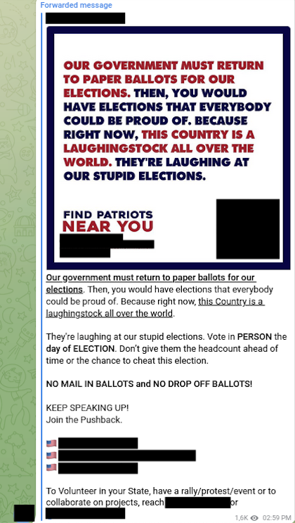
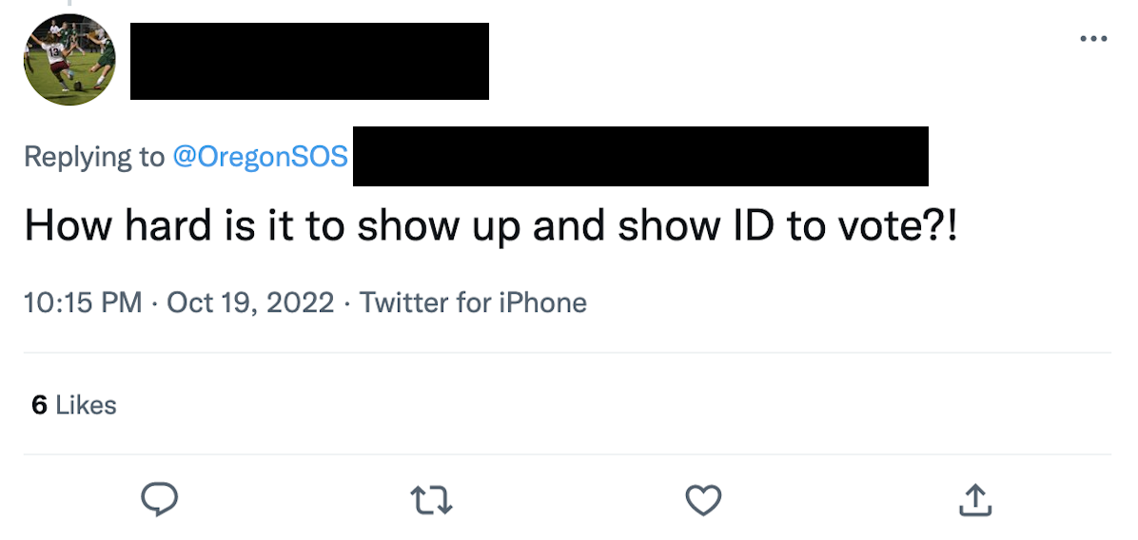
Narrative 2: Oregon should eliminate mail-in ballots and hold in-person voting that requires voter ID. (Continuing narrative)
(See link here.)
(See link here.)

Slide 16
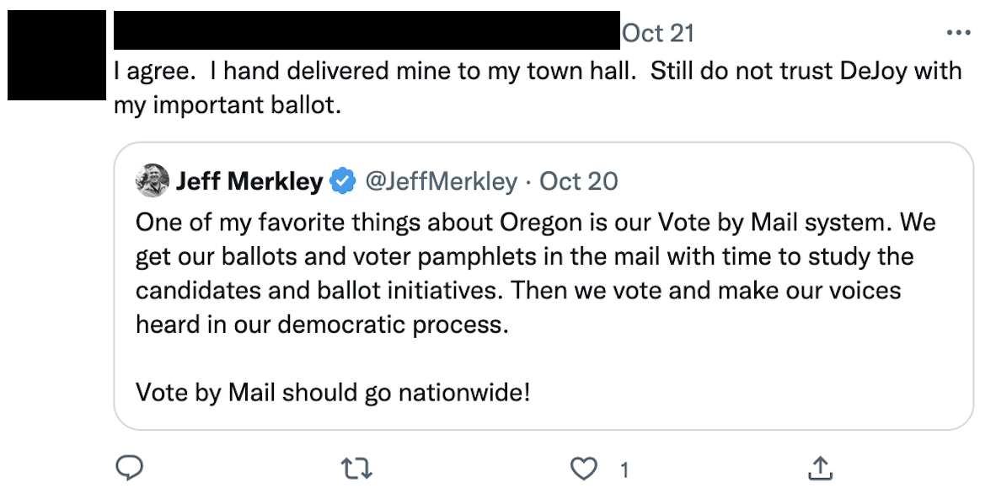
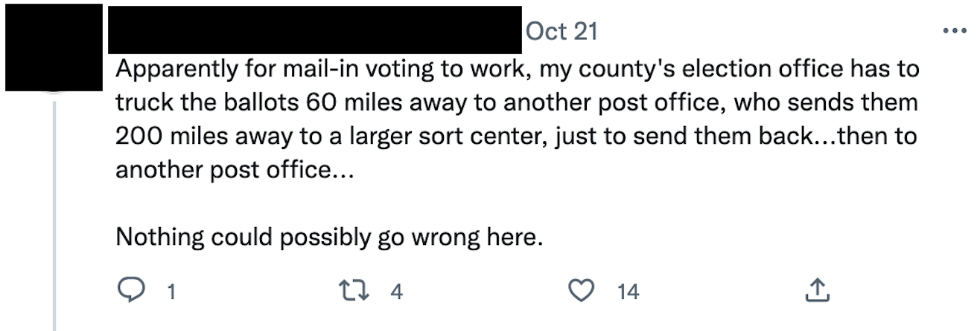
Narrative 3: The US Postmaster General should replaced for mail-in ballots to be secure. (Continuing narrative)
(See link here.)
(See link here.)

Slide 17
Narrative 4: Voter and election fraud occur through ballot harvesting. (Continuing narrative)
(See link here.)
(See link here.)

Slide 18
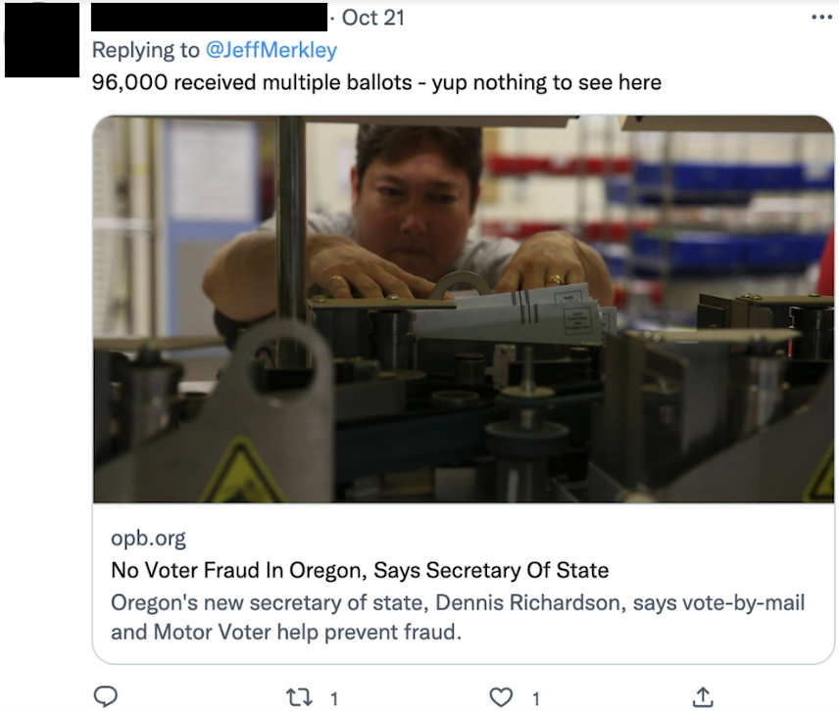
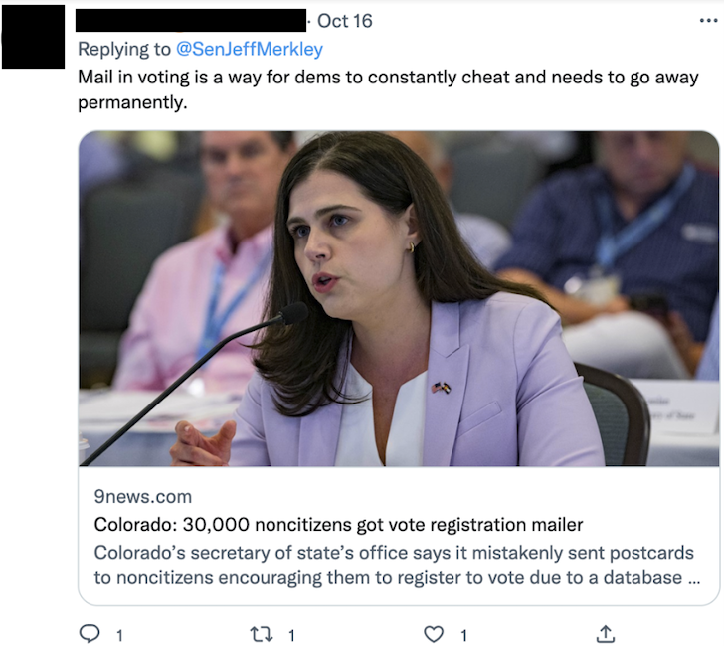
Narrative 5: Mail-in ballots can’t be trusted because they are “error prone.”
(See link here.)
(See link here.)

Slide 19
Narrative 6: People’s mail-in ballots are being filled out by others.
(See link here.)
(See link here.)

Slide 20
Narrative 7: Oregonians’ votes were not counted.
(See link here.)
(See link here.)

Slide 21
Appendix B:
Existing MDM Narratives

Slide 22
Existing MDM Narratives
Narrative | Risk | Reporting Period(s) Observed | Continuing (Yes/No)
Mail-in ballots are used to commit voter and election fraud in Oregon. | High | 7/15-8/12; 8/12-8/19; 8/19-8/26; 8/26-9/2; 9/2-9/9; 9/9-9/16; 9/16-9/23; 9/23-9/30; 9/30-10/7; 10/7-10/14; 10/14-10/21 | Yes
Future elections can’t be trusted due to the fraudulent 2020 elections. | High | 7/15-8/12; 8/12-8/19; 8/19-8/26; 8/26-9/2; 9/2-9/9; 9/9-9/16; 9/16-9/23; 9/23-9/30; 9/30-10/7; 10/7-10/14; 10/14-10/21 | Yes
Election fraud has been happening in Oregon for decades. | Medium | 7/15-8/12; 8/12-8/19; 8/19-8/26; 8/26-9/2; 9/2-9/9; 9/9-9/16; 9/16-9/23; 9/23-9/30; 9/30-10/7; 10/7-10/14; 10/14-10/21 | Yes

Slide 23
Existing MDM Narratives
Narrative | Risk | Reporting Period(s) Observed | Continuing (Yes/No)
Voter and election fraud occur through ballot harvesting. | Medium | 8/12-8/19; 8/19-8/26; 8/26-9/2; 9/2-9/9; 9/9-9/16; 9/16-9/23; 9/23-9/30; 9/30-10/7; 10/7-10/14; 10/14-10/21 | Yes
People should not trust voting machines because they enable election fraud. | Low | 8/12-8/19; 8/19-8/26; 8/26-9/2; 9/2-9/9; 9/9-9/16; 9/16-9/23; 9/23-9/30; 9/30-10/7; 10/7-10/14; 10/14-10/21 | Yes
Twitter is manipulating the 2022 elections by suppressing support for an Oregon candidate for governor. | High | 9/9-9/16 | No

Slide 24
Existing MDM Narratives
Narrative | Risk | Reporting Period(s) Observed | Continuing (Yes/No)
Election officials will commit election fraud to prevent Republican candidates from winning. | Low | 9/16-9/23; 9/23-9/30; 9/30-10/7; 10/7-10/14; 10/14-10/21 | Yes
Oregon’s mail-in ballots are not anonymous because they contain QR codes/unique identifiers. | Medium | 9/16-9/23 | No
Illegal immigrants are voting. | Low | 7/15-8/12; 8/12-8/19; 8/19-8/26; 8/26-9/2; 9/2-9/9; 9/9-9/16; 9/16-9/23; 9/23-9/30; 9/30-10/7; 10/7-10/14; 10/14-10/21 | Yes

Slide 25
Existing MDM Narratives
Narrative | Risk | Reporting Period(s) Observed | Continuing (Yes/No)
The US Department of Justice (DOJ) is allowing voter and election fraud. | Medium | 9/9-9/16 | No
Peoples’ votes for POTUS 45 in the 2020 election were not counted. | Medium | 8/12-8/19 | No
Mail-in ballots are used to commit election fraud as non-Oregon residents are voting. | Low | 8/12-8/19; 8/19-8/26; 8/26-9/2; 9/2-9/9; 9/9-9/16; 9/16-9/23; 9/23-9/30; 9/30-10/7; 10/7-10/14; 10/14-10/21 | Yes

Slide 26
Existing MDM Narratives
Narrative | Risk | Reporting Period(s) Observed | Continuing (Yes/No)
People should not trust mail-in ballots because signature verification is ineffective. | Low | 8/12-8/19; 8/19-8/26; 8/26-9/2; 9/2-9/9; 9/9-9/16; 9/16-9/23; 9/23-9/30; 9/30-10/7; 10/7-10/14; 10/14-10/21 | Yes
Oregon should eliminate mail-in ballots and hold in-person voting that requires voter ID. (Continuing narrative) | High | 8/12-8/19; 8/19-8/26; 8/26-9/2; 9/2-9/9; 9/9-9/16; 9/16-9/23; 9/23-9/30; 9/30-10/7; 10/7-10/14; 10/14-10/21 | Yes
Ineligible voters can vote due to the Oregon Motor Voter Act of 2016. | Medium | 9/30-10/7 | No

Slide 27
Existing MDM Narratives
Narrative | Risk | Reporting Period Observed | Continuing (Yes/No)
People can vote multiple times via mail-in ballots. | Low | 8/12-8/19; 8/19-8/26; 8/26-9/2; 9/2-9/9; 9/9-9/16; 9/16-9/23; 9/23-9/30; 9/30-10/7; 10/7-10/14; 10/14-10/21 | Yes
Oregon should conduct a full election audit due to widespread election fraud. | Low | 7/15-8/12; 8/12-8/19; 8/19-8/26; 8/26-9/2; 9/2-9/9; 9/9-9/16; 9/23-9/30; 9/30-10/7; 10/7-10/14; 10/14-10/21 | Yes
Oregon election officials are not being transparent about the election process. | Low | 8/12-8/19; 8/19-8/26; 8/26-9/2; 9/2-9/9; 9/9-9/16; 9/16-9/23; 9/23-9/30; 9/30-10/7; 10/7-10/14; 10/14-10/21 | Yes

Slide 28
Existing MDM Narratives
Narrative | Risk | Reporting Period Observed | Continuing (Yes/No)
HB 3291 will open the midterm election to more voter and election fraud. | Low | 8/26-9/2; 9/16-9/23 | No
Allowing formerly incarcerated individuals to vote enables voter and election fraud. | Low | 9/2-9/9; 9/9-9/16; 9/30-10/7; 10/7-10/14 | No
Oregon election officials committed election fraud by altering voters’ registration. | Low | 8/12-8/19; 9/30-10/7; 10/7-10/14; 10/14-10/21 | Yes

Slide 29
Existing MDM Narratives
Narrative | Risk | Reporting Period Observed | Continuing (Yes/No)
Twitter will influence the outcome of the 2022 midterm elections by enforcing its Civic Integrity Policy. | Low | 7/15-8/12 | No
Allowing same day registration will increase the likelihood of voter fraud and election fraud through mail-in voting. | Low | 8/19-8/26 | No
People are using mail-in ballots received by deceased people in Oregon to commit voter fraud. | Low | 8/12-8/19; 8/19-8/26; 8/26-9/2; 9/2-9/9; 9/9-9/16; 9/16-9/23; 9/23-9/30; 9/30-10/7; 10/7-10/14; 10/14-10/21 | Yes

Slide 30
Existing MDM Narratives
Narrative | Risk | Reporting Period Observed | Continuing (Yes/No)
People should monitor drop boxes to prevent voter fraud. | Low | 9/16-9/23; 9/23-9/30; 9/30-10/7; 10/7-10/14; 10/14-10/21 | Yes
Election officials are setting unreasonably high prices to block access to election records. | Low | 9/2-9/9 | No
Election officials are excluding volunteer poll workers on a partisan basis. | Low | 9/23-9/30 | No

Slide 31
Existing MDM Narratives
Narrative | Risk | Reporting Period Observed | Continuing (Yes/No)
Oregon election officials need to update voter rolls to prevent voter fraud. | Low | 8/12-8/19; 8/19-8/26; 8/26-9/2; 9/2-9/9; 9/16-9/23; 9/23-9/30; 9/30-10/7; 10/7-10/14;; 10/14-10/21 | Yes
Voters should be able to track their ballots. | Low | 9/30-10/7; 10/7-10/14; 10/14-10/21 | Yes
People can’t trust mail-in ballot drop boxes because they are not secure. | Low | 9/30-10/7; 10/7-10/14; 10/14-10/21 | Yes

Slide 32
Appendix C: Definitions

Slide 33
Definitions
Misinformation - false, but not created or shared with the intention of causing harm
Disinformation - deliberately created to mislead, harm, or manipulate a person, social group, organization, or country
Malinformation - based on fact, but used out of context to mislead, harm, or manipulate
Topic - the broader subject defining the information environment (ex. Midterm Elections)
Theme - subtopics or categories of discourse (ex. Mail-in ballots)
Narrative - at least more than one piece of content that shares a similar rhetorical objective (ex. County clerks are using mail-in ballots to steal elections)
Voter Fraud - unlawful voting by individuals (ex. voting more than once)
Election Fraud - unlawful actions that undermine election integrity (ex. tampering with official election materials)

